Slide 1
Artificial Intelligence
Year 13

Slide 2

Objectives
At the end of the lesson students should be able to:
State what is Artificial intelligence
The purpose of graphs in artificial intelligence
Comprehend how graphs represent relationships and structures in AI applications.
Recognize the use of graphs in various AI tasks such as search algorithms, knowledge representation, and social network analysis.
Use A* (Star) algorithm to find the short point in a graph
Use Dijkstra’s algorithms to find the shortest path in a graph

Slide 3
What is artificial intelligence?
It is the ability for computers perform tasks that usually only a human would be able to do, such as decision making, speech recognition, etc.
Machine learning and AI
Machine learning is a subset of artificial intelligence where computers learn to perform tasks without explicitly being programmed how to e.g. Email Spam filters.
With Machine Learning (ML) computers are fed historical training data and this data is used to produce a model from which predictions about previous unseen data can be made.

Slide 4
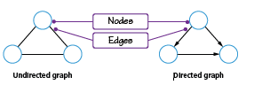
Machine learning and graph
Graph AI
Graph AI is the science of using Machine Learning on graphs to focus on the relationships between variables to achieve deeper insights.
These include problems where centrality, connectivity, and path analysis play a key role in the analysis
What is a graph?
A graph is a non-linear data structure consisting of nodes and edges that join a pair of nodes.
If the edges have a direction from one node to the other, it is a directed graph.

Slide 5
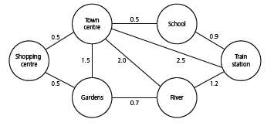
A path from school to gardens could be path = (school, train station, river, garden
Structure of a Graph
Nodes (Vertices): Represent entities or points of interest (e.g., locations, objects).
Edges: Represent connections or relationships between nodes (can be directed or undirected).
Weighted Graphs: Edges may carry weights (e.g., distances, costs) to represent varying strengths of connections.

Slide 6
A path from school to gardens could be path = (school, train station, river, garden
Types of Graph
Directed vs. Undirected Graphs:
Directed Graphs: Edges have a direction, indicating a one-way relationship.
Undirected Graphs: Edges have no direction, indicating a two-way relationship.

Slide 7
A path from school to gardens could be path = (school, train station, river, garden
Common Graph Types in AI
Decision Trees: Used for decision-making processes.
Knowledge Graphs: Represent structured knowledge and relationships in AI systems.
Social Graphs: Capture relationships in social networks, aiding recommendation systems.

Slide 8
A path from school to gardens could be path = (school, train station, river, garden
Graphs are used to represent real life networks, such as
Bus/train routes where the nodes are bus stops, and the edges connect two stops next to each other
websites where each web page is a node, and the edges show the links between each web page
social media networks where each node contains information about a person and the edges connect people who are friends.

Slide 9
Key Algorithms-- AI
Search Algorithms:
Breadth-first search (BFS)
Depth-first search (DFS) for traversing graphs.
Shortest Path Algorithms:
Dijkstra's algorithm
A* algorithm for finding optimal paths.

Slide 10
Shortest path Algorithms
The shortest path algorithm is a method used to determine the shortest path (or minimum distance) between two nodes in a graph.
It is fundamental in various applications such as routing, navigation, and network analysis

Slide 11
Dijkstra’s algorithm
Dijkstra’s algorithm (pronounced dyke – strah) is a method of finding the shortest path between two points on a graph.
Finds the shortest path from a single source node to all other nodes in a weighted graph with non-negative weights.
Uses a priority queue to explore the nearest unvisited node and updates the shortest known distances.
It is the basis of technology such as GPS tracking which is an important part of AI.

Slide 12
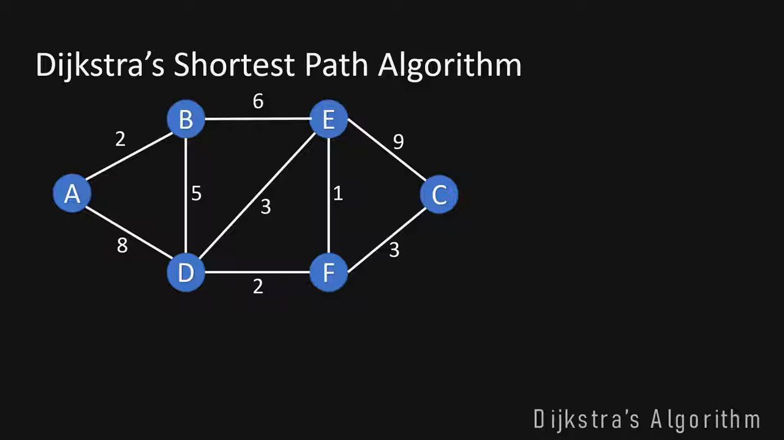
How to calculate the shortest part using Dijkstra” Algorithm

Slide 13
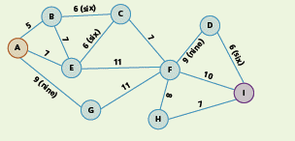
Activity Complete the following Questions
The following graph shows the routes through a large park.
Use Dijkstra’s algorithm to find the shortest path from point A to point I.

Slide 14
Limitations
A lack of heuristics: Dijkstra’s algorithm has no notion of the overall shortest direction to the end goal, so it will actually spend a lot of time searching in completely the wrong direction if the routes in the wrong direction are shorter than the route in the correct direction. It will find the shortest route in the end but it will waste a lot of time.
In small networks this isn’t a problem but when you have massive networks (like road networks or the internet) then it will result in massive inefficiencies.
Negative Weighted Costs: On physical networks with physical distances you can’t have negative weights, but one some networks where you are calculating costs you might have negative costs for a particular leg. Dijkstra’s cant handle these negative costs.
Directed networks: Dijkstra’s algorithm doesn’t always work best when there are directed networks (such as motorways that only run in one direction.

Slide 15
A *(Star) Algorithm

Slide 16
A * Algorithm
One of the biggest problems with Dijkstra’s algorithm is that it is that it has the potential to be inefficient when searching for the shortest path, because it just looks for the next shortest leg.
It simply checks each vertex looking for the shortest path, even if that takes you away from your destination – it pays no attention to direction.
With larger, more complex problems, that can be a time-consuming drawback.
A *
A* algorithm is based on Dijkstra but adds an extra heuristic (h) value – an ‘intelligent guess’ on how far we have to go to reach the destination most efficiently.

Slide 17
A * Algorithm
The A algorithm* is a popular pathfinding and graph traversal algorithm used to find the shortest path from a starting node to a target node.
It is
Heuristic-Based: Combines the cost to reach the current node and an estimated cost to reach the goal, optimizing the search process.
Optimal and Complete: Guarantees finding the shortest path if the heuristic is admissible (never overestimates the true cost).
It is widely used in fields such as AI, robotics, and game development due to its efficiency and accuracy.
A* algorithm is based on Dijkstra but adds an extra heuristic (h) value – an ‘intelligent guess’ on how far we have to go to reach the destination most efficiently.

Slide 18
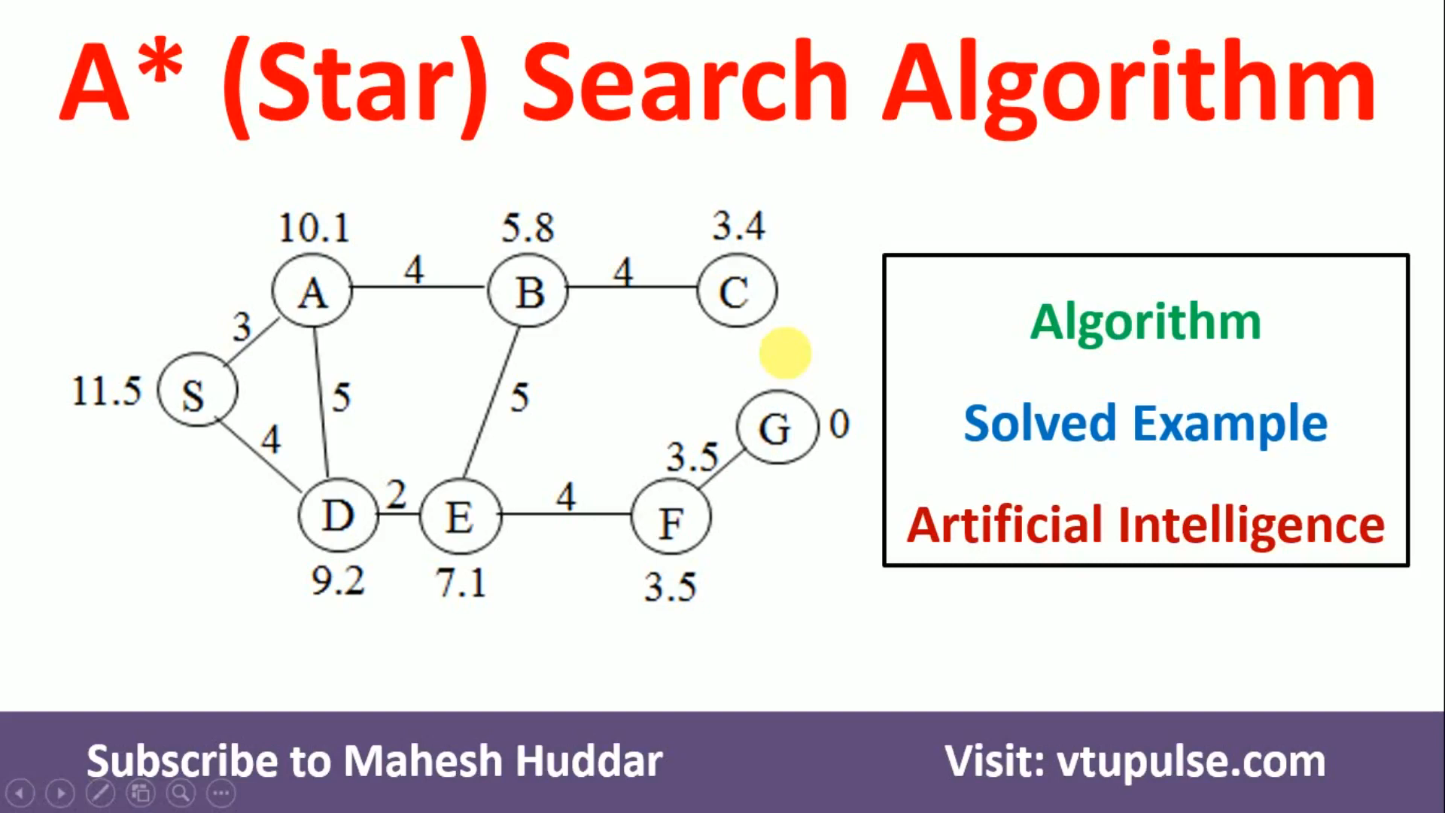
How to calculate the Shortest Part using A * Algorithm

Slide 19
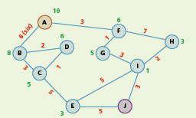
Activity
Find the shortest route from node A to node J using the A* algorithm.
Note that you are given the heuristic values (h) in green, and the movement cost values (g), in red

Slide 20
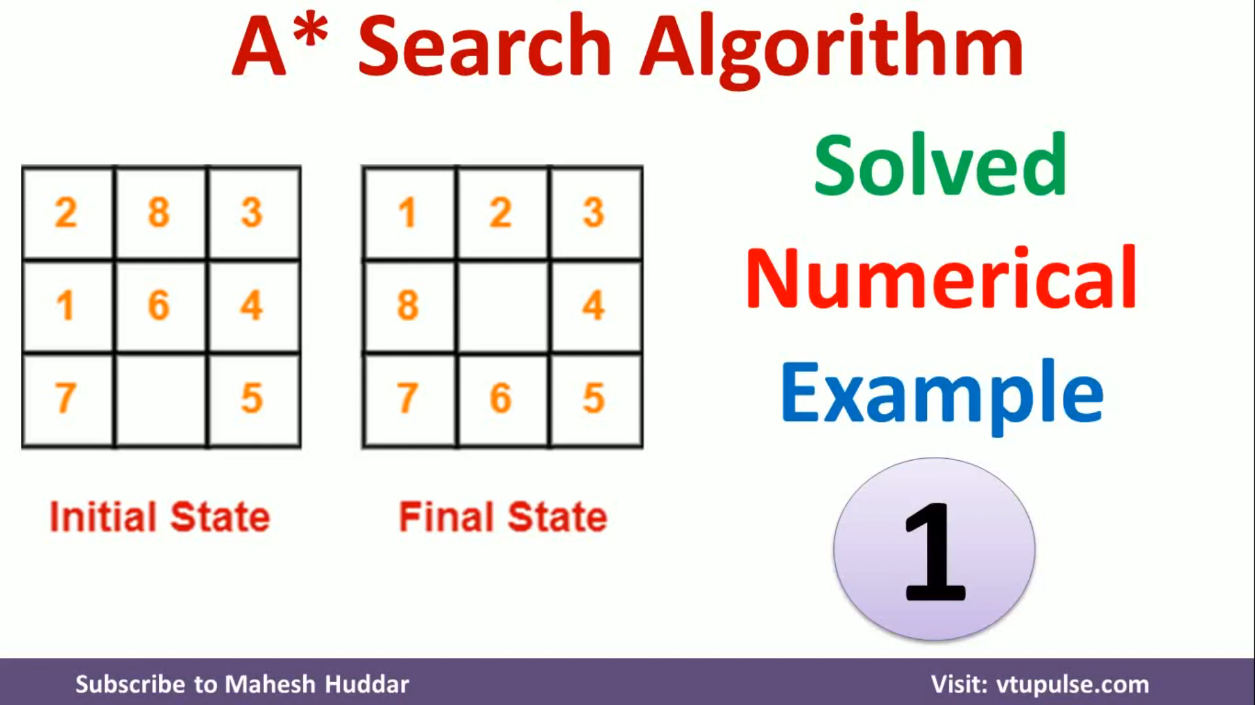
How to calculate the Shortest Part using A * Algorithm

Slide 21
Activity
Complete the work on the given worksheet

Slide 22
THANK YOU
Mirjam Nilsson
206-555-0146
mirjam@contoso.com
www.contoso.com

